Slide 1

IPL Analysis - Power BI Report
Nikhil Jaiswal
2025

Slide 2
1. Introduction
This Power BI report provides an in-depth analysis of IPL (Indian Premier League) statistics, covering key metrics such as team performances, individual player statistics, match outcomes, and venue-based trends.

Slide 3
2. Data Sources
The dataset includes IPL match records, player statistics, and team performances.
Data is structured to provide insights into historical trends, including top batsmen, bowlers, and team performances.

Slide 4
Procedure
Step 1: Data Collection
Step 2: Data Preprocessing
Step 3: Import Data into Power BI
Step 4: Data Modeling & Relationships
Step 5: Creating Visualizations
Step 6: Analyzing Insights
Step 7: Publishing & Sharing Reports
1
2
3

Slide 5

3. Key Insights & Metrics
A. Season Overview
Title Winner: Kolkata Knight Riders
Purple Cap Winner: YS Chahal (Most Wickets: 213)
Orange Cap Winner: V Kohli (Most Runs: 8014)

Slide 6
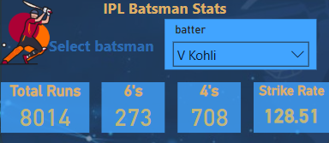
Batsman Statistics
Batsman: V. Kohli
Total Runs: 8014
Sixes: 273
Fours: 708
Strike Rate: 128.51

Slide 7
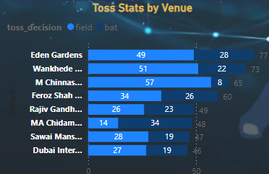
Toss Analysis
Toss Stats by Venue:
Highest toss counts observed at Eden Gardens (77), Wankhede (73), and M. Chinnaswamy Stadium (65).
Decision after winning the toss: 64.29% opted to field, 35.71% opted to bat.
Win types:
52.79% of matches won by wickets
45.48% of matches won by runs

Slide 8
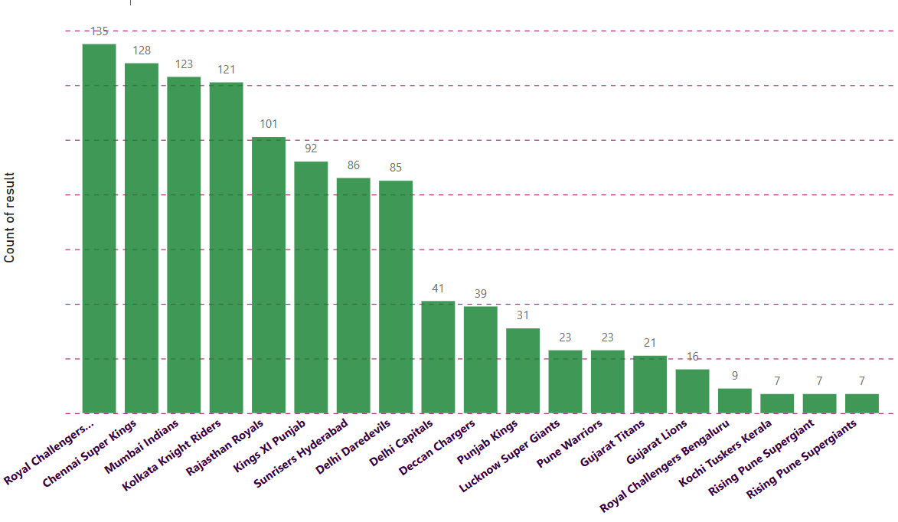
Match Results
Total Matches Won by Teams:
Royal Challengers Bangalore: 135 wins
Chennai Super Kings: 128 wins
Mumbai Indians: 123 wins
Kolkata Knight Riders: 121 wins

Slide 9
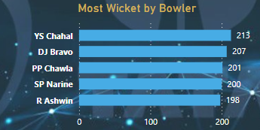
Top Bowlers
Most Wickets Taken by Bowlers:
YS Chahal: 213
DJ Bravo: 207
PP Chawla: 201
SP Narine: 200
R Ashwin: 198

Slide 10
4. Visualizations Used
Bar Charts: Used for match results, top batsmen, and top bowlers
Pie Charts: Used for toss decisions and match result distribution.
Tables: For summarizing top players, team performances, and seasonal statistics.

Slide 11
5. Conclusion
This Power BI report provides a detailed view of IPL statistics, enabling insights into player performances, toss trends, and team success rates. The analysis can be used for predictive modeling and strategic planning in cricket analytics

